Slide 1
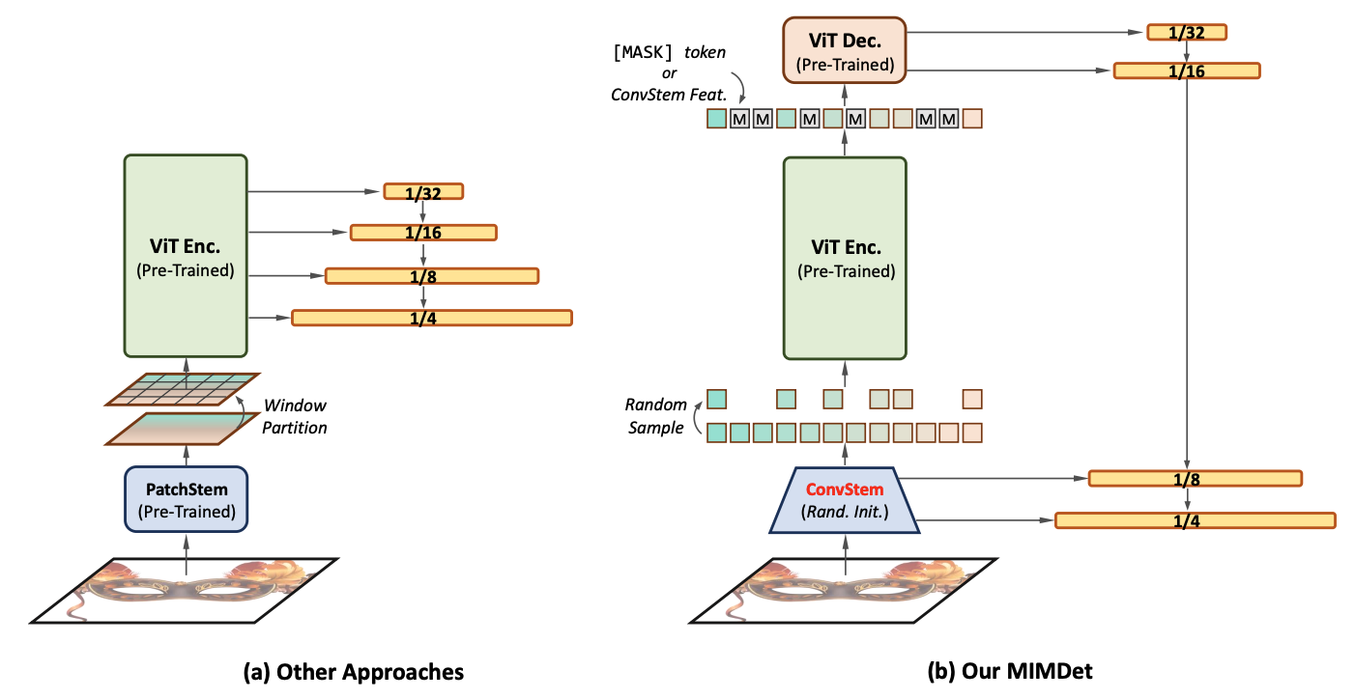
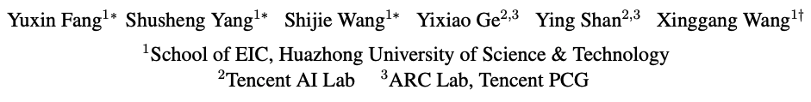
Unleashing Vanilla ViT with Masked Image Modeling for Object Detection

Slide 2
Unleashing Vanilla ViT with Masked Image Modeling for Object Detection
Entering the 2020s, ViT is rapidly transferring the landscape of computer vision.
Swin Transformer, seamlessly incorporates the local window attention into a hierarchical macro architecture.
Masked Image Modeling is a computer vision technique that involves predicting the missing pixels in an image by using the surrounding pixels as context.

Slide 3
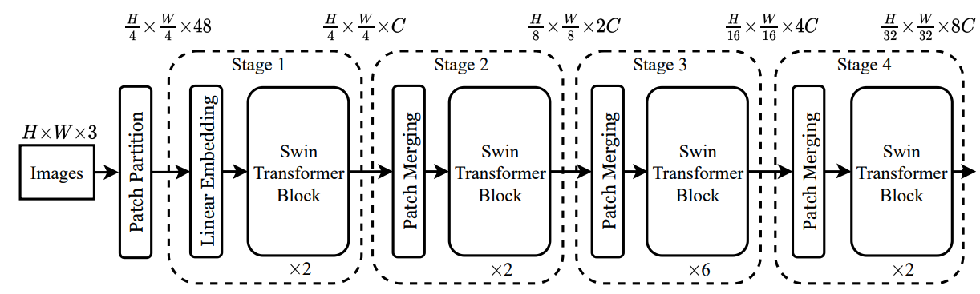
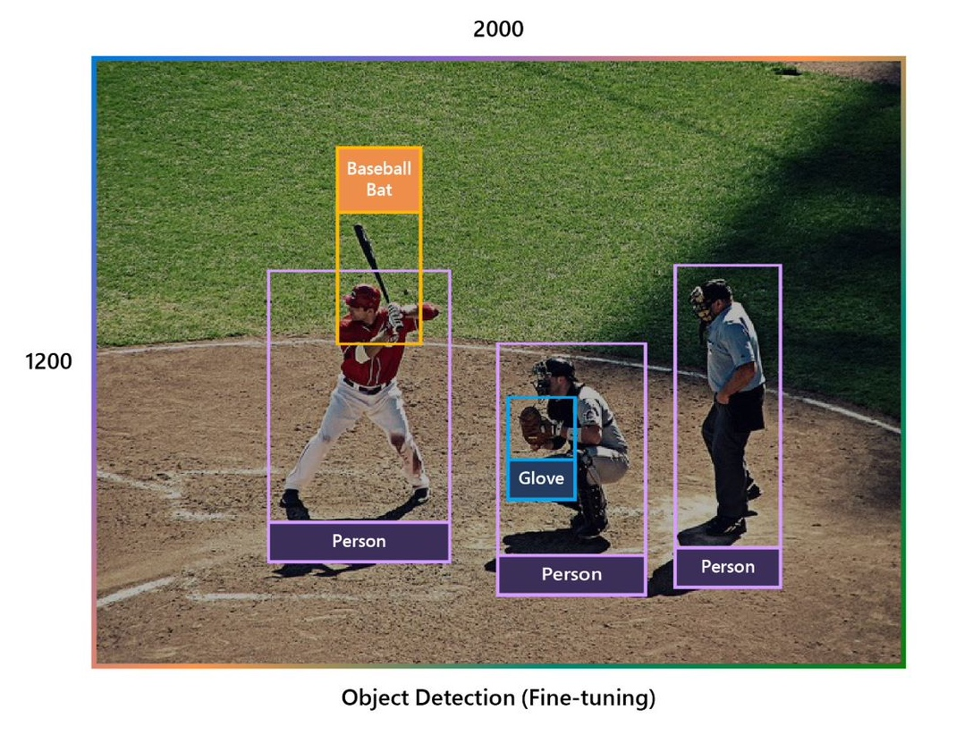
Unleashing Vanilla ViT with Masked Image Modeling for Object Detection
Head
Shifted Windows Transformer
Vision Transformers use self-attention to capture long-range dependencies and global context across the entire image, which is crucial for understanding complex patterns and relationships.

Slide 4
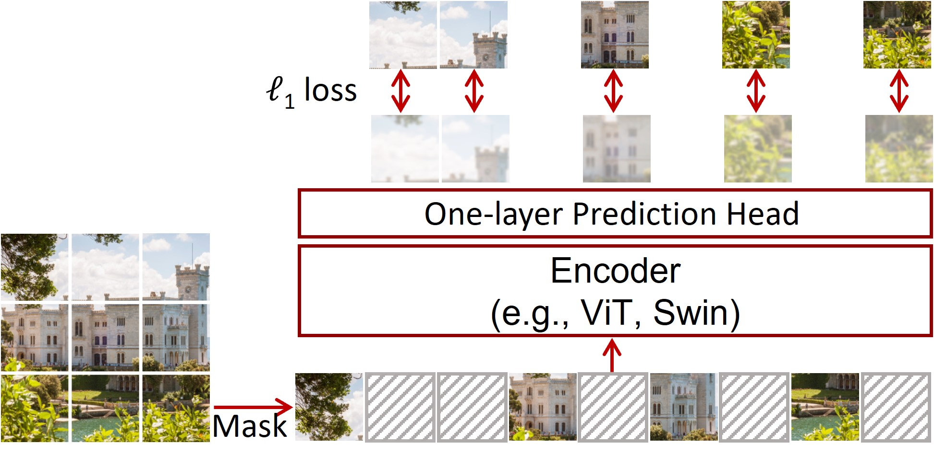
Unleashing Vanilla ViT with Masked Image Modeling for Object Detection
SimMIM: a Simple Framework for Masked Image Modeling
MIM involves masking parts of an image and training a model to predict the missing regions based on the unmasked parts. This self-supervised approach helps the model learn rich, high-level features without relying on explicit labels.

Slide 5
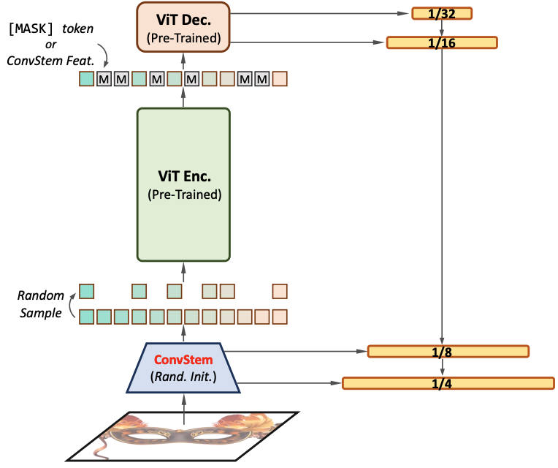
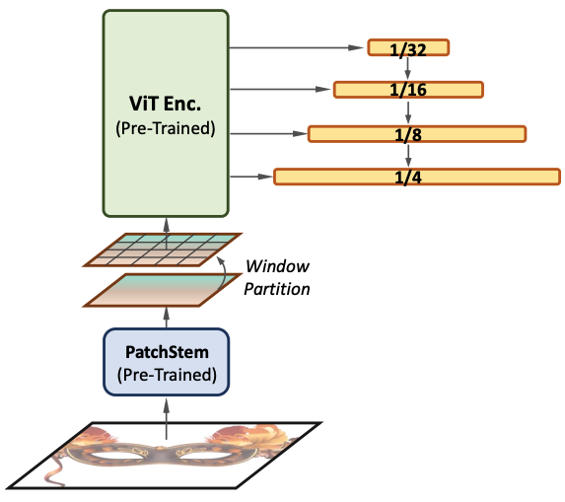
Unleashing Vanilla ViT with Masked Image Modeling for Object Detection
ViT often requires more computational resources compared to traditional CNN models. The self-attention mechanism of Transformers has high computational complexity, especially with large-sized images

Slide 6
Unleashing Vanilla ViT with Masked Image Modeling for Object Detection
We feed the MIM pre-trained ViT encoder with only a partial input, e.g., only 25% ∼ 50% of the input sequence of embeddings with random sampling.
The output sequence fragments are then complemented with learnable tokens (e.g., [MASK] tokens) and processed by a lightweight decoder to recover the full feature map.
hidden patches
patches

Slide 7

Masked Image Modeling – Simple CNN
MIM involves learning to recover or reconstruct an image from the remaining parts. This helps the model learn the representations of the image without needing the complete information.
Divide the image into patches: The input to the model is typically an image divided into smaller patches.
Mask a portion of the image: A percentage of the patches are randomly masked or removed.
Pass the input through an Encoder Network: The non-masked patches are fed into an encoder network, such as a transformer or a CNN.

Slide 8
Masked Image Modeling – Simple CNN
Generate hidden representations: The encoder creates a latent spatial representation of the remaining patches. This representation contains the necessary information to reconstruct the masked patches.
Predict the masked patches: The latent representations are fed into a decoder network, which aims to reconstruct or recover the masked patches from these representations.
Compute the loss: The loss between the predicted patches and the original patches is calculated. The goal is to minimize the difference between the predicted patches and the original patches.
Train the model: The model is trained to optimize the loss, thereby learning to better predict the masked patches from the remaining patches. The training process typically uses optimization algorithms such as gradient descent to update the model's parameters.

Slide 9
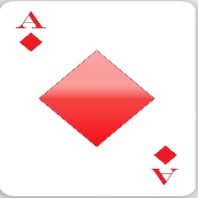
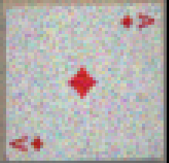
Masked Image Modeling – Simple CNN
Input
Masked
Encoder
Decoder
Randomly mask 25% of the patches
mask = torch.rand(img.size(0), 3, img.size(2), img.size(3)) > 0.25 masked_img = img * mask
Randomly tensor [batch_size, 3, height, width]: value from [0..1]
#Images/batch
Input chanel
Input height
Input width
Compare each value in the tensor to 0.25. The result is a boolean tensor with values True (1) or False (0)
masked_img = img * mask: multiply input ([batch_size, 3, height, width]) with 0/1

Slide 10
Masked Image Modeling – Simple CNN
Input
Masked
Encoder
Decoder
nn.Conv2d(3, 16, 3, padding=1), nn.ReLU(), nn.MaxPool2d(2, 2), nn.Conv2d(16, 4, 3, padding=1), nn.ReLU(), nn.MaxPool2d(2, 2)
nn.ConvTranspose2d(4, 16, 4, stride=2, padding=1), nn.ReLU(), nn.ConvTranspose2d(16, 3, 4, stride=2, padding=1), nn.Sigmoid()
# Forward pass output = model(masked_img) loss = criterion(output, img) # Backward pass and optimization optimizer.zero_grad() loss.backward() optimizer.step()

Slide 11
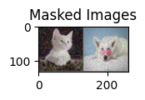
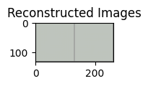
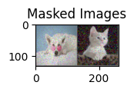
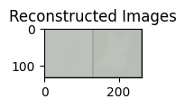

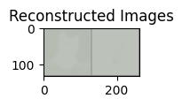

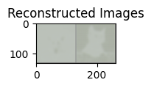

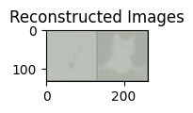

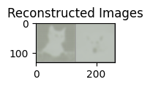

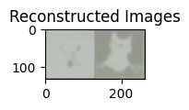

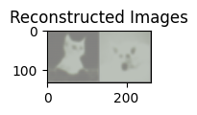
Masked Image Modeling – Simple CNN

Slide 12






Epoch=100
Train_loss=0.17
Val_loss=0.17
Epoch=25
Train_loss=0.18
Val_loss=0.18
Epoch=5
Train_loss=0.23
Val_loss=0.21
Epoch=4
Train_loss=0.34
Val_loss=0.27
Epoch=2
Train_loss=0.49
Val_loss=0.41
Epoch=1
Train_loss=0.61
Val_loss=0.58

Slide 13
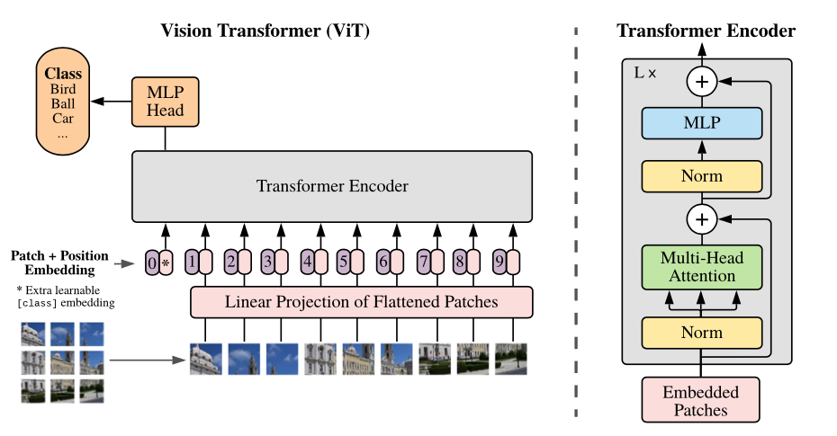
Vision Transformer Encoder

Slide 14
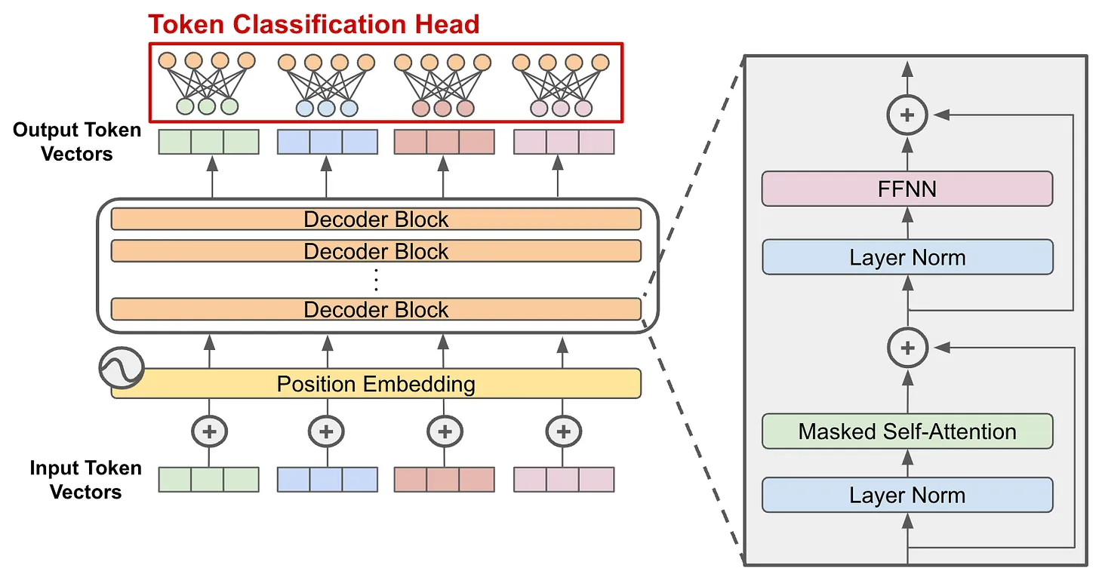
Vision Transformer Decoder

Slide 15
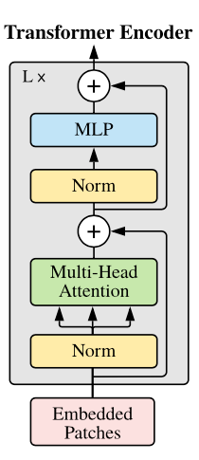
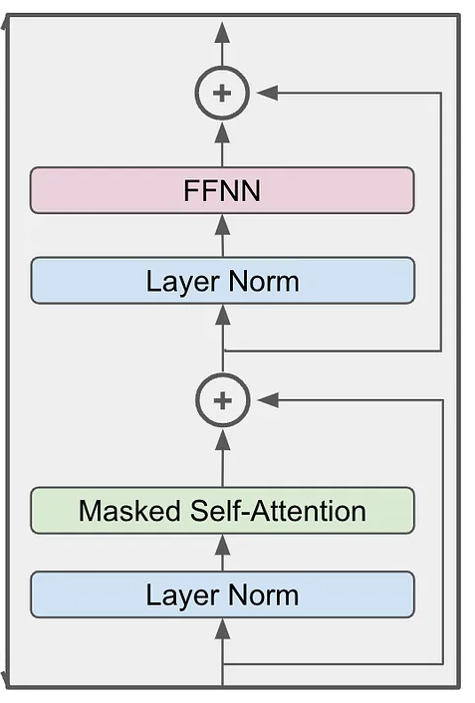
Vision Transformer MIM
Transformer Decoder

Slide 16
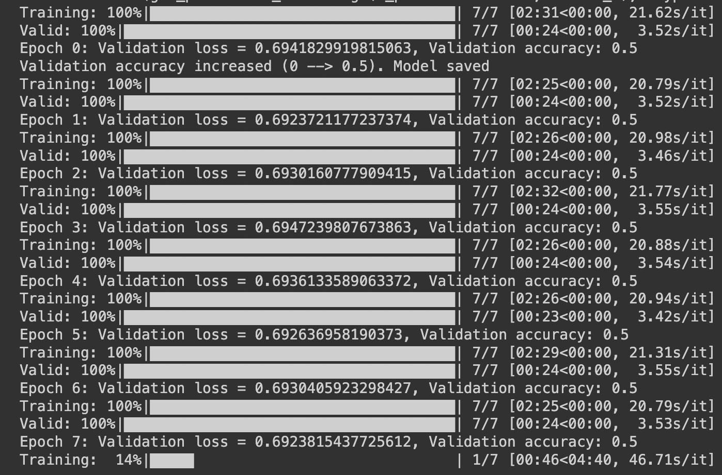
Implementation

